Slide 1


Skating Pathways
CanSkate/CanPowerSkate
Star Preparatory/Jr. Prep.
Star Skate Competitive
(Recreational) (High Level)

Slide 2
11 Key Factors Influencing LTD
At least 11 years to reach the top
Physical Literacy
Specialization
Developmental Age (growth, development, maturation)
Windows of optimal trainability (5 S’s)
Physical, mental, cognitive, and emotional development.
Periodization: planning, training, competition and recovery
Domestic competition review
System alignment and integration
Continuous improvement
Develop a long-term plan

Slide 3
5 S’s – Windows of Optimal Trainability
Trainability is the responsiveness/adaptation to a training stimulus at different stages of growth and maturation
Stamina (Endurance)
2. Strength
3.Speed
4. Skills
5. Suppleness (Flexibility)

Slide 4
CanSkate/CanPowerSkate/StarPrep
1 to 2 times a week
Group Lessons/Parent and Tot/Open to all ages
Certified Coaches, Coaches in Training, and Program Assistants
Introduction to Basic Skating Skills Agility, Balance, Control
Identify keen skaters shows ability and talent and communicate information to parents regarding accelerate programing.
Offer off-ice activities if ice time is limited
Pre-Star/Jr. Prep/Advanced CanSkate – 2 to 3 times a week
Carnivals and Ice Shows, Funfest!

Slide 5
Star Skate 1 to 5
2 to 3 times a week
Off-Ice Training and Involvement in other Sports
Group/Semi-Private/Private Lessons/Yearly Training Plan
Introduction figure skating programing – free skate, skating skills, dance, pair skating, artistic, synchro
Introduction to competitions and tests
Testing done by coach
Ice Shows, Exhibitions, Simulations, Prospects Program
Celebration of Achievements
Identify keen skaters and talk to parents for possible increase commitment level (time, financial, competitions/assessments)

Slide 6
Star Skate 6 to 10/Gold/Competitive
4 to 5 times a week
Increase of complex skill development
Group/Semi-Private/Private Lessons, Yearly Training Plan, Off-Ice Training
Higher Level Skates
Tests done by certified assessors
Ice Shows, Exhibitions, Simulations, Prospects Program
Apply for the Team Saskatchewan – Competitive, High Performance, Elite

Slide 7
Special Olympics
Things to Consider
Athletes, clubs, and coaches have to be registered with Special Olympics.
Athletes, clubs, and coaches must be registered with Skate Canada.
Coaches volunteer if on designated S.O. ice
Coaches can be paid if on regular club programing ice (there are exceptions)
Program Assistants are volunteers (must be registered with SC).
On-ice one-on-one aids do not have to pay S.C. registration fees.
Coach & PA Ratio: one on one, 1 Coach to 4 Athletes.
Meet parents prior to first session get to know the S.O. athlete.
Develop a strategy for communication.
Coaches must take a course for competitive S.O. skaters.
Grants and funding available.

Slide 8
Special Olympics
Who
Anybody who has an intellectual disability (disabilities).
All ages 2yr and up.
No experience needed
What
Proper equipment
Helmet (cage), Proper Skates, Knee & Elbow Pads
Where S.O. fit
Canskate, CanpowerSkate, Recreation Star and Competitive pathways.

Slide 9
Adaptive & Inclusive Skating
Teaching aids for persons with special needs or disability.
  Program Assistants
  Balance aids (stability devices).
  Customize the needs of the skater.
  Skate Canada Link: https://skatecanada.ca/2023/10/adaptive-canskate-is-a-win-for-everyone/
Listen to 2SLGBTQIA+ members and persons in your community with empathy, respect, and compassion. Their stories are valid and important sources of information and knowledge!
Educate yourself, educate others. There are many excellent resources available that provide general and sport-specific information on 2SLGBTQIA+ inclusion that are available through Skate Canada’s website at https://skatecanada.ca/safe-sport/.

Slide 10
S.O. Event Opportunities
All Skate Canada tests (can be different than mainstream)
Competitions - S.O. or Mainstream
S.O. Event Opportunities
Club
Can participate in any competitions or events that is recognized by designated sanctioned Skate Canada events.
Carnivals and Ice shows.
Regional
Provincial
National
Canada Winter Games
S.O. Winter Games
National Championships
Need to qualify
International
Winter Games
World Championships)
Need to Qualify

Slide 11
Events Calendar
Sask. Skate Competition – October 4th to 6th Regina, SK
Pre-Novice/Novice/Junior/Senior Sectional Championships – November 8th to 10th: Humboldt, SK
Rising Stars Seminars
Swift Current: Saturday, November 23rd
Arcola, SK: Sunday, November 24th
Tisdale, SK: November 30th
North Battleford, SK: December 1st
Pre-Juvenile/Juvenile Sectional Championships – December 13th to 15th: Rosetown, SK
STARSkate Invitational Competition – December 13th to 15th: Rosetown, SK
Star & Black Boots Seminar – January 4th: Saskatoon, SK
Prospects Program Simulations – January 5th: Saskatoon, SK
Regional Competitions – January/February 2025
Winter Classic Competition – February 28th to March 2nd: Regina, SK
Spring Competition – April (usually Edmonton, Alberta)
Summer Competitions – August (Manitoba, Alberta, BC, Ontario)

Slide 12
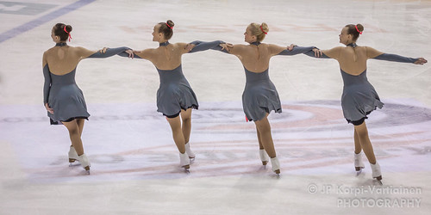
SYNCHRONIZED SKATING
Categories
Juvenile > Pre-Novice > Novice> Intermediate (Gold) > Open
Junior > Senior > Senior Elite 12
Events
Skate Canada Synchro Classic – December
Prairie Regional Synchronized Skating Competition – February
Living Skies Synchronized Skating Competition – March

Slide 13
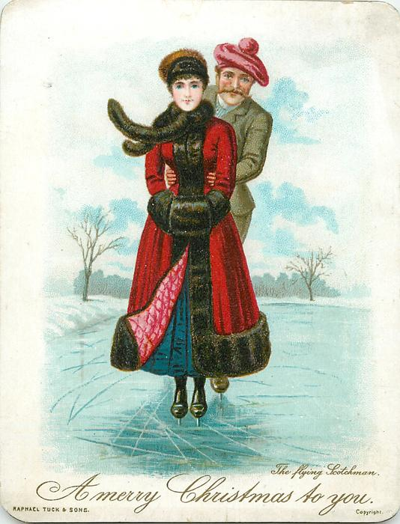
Active for Life
Adult Skating
Competitions, Synchro, Skills Testing
Coaching
Program Assistant, CanSkate, CanPowerSkate, Regional, Provincial, National, High Performance
Skating Official
Judge, Technical Specialist, Data Specialist, Assessor
Club Volunteering
Carnival, Ice Shows, Test Days, Club Board Member,
Section or National Board Member
Attend Provincial/National/International Conferences and Seminars
This Photo by Unknown Author is licensed under CC BY

Slide 14
Prospects Program
Inclusivity with opportunities to expand access to more skaters at a variety of levels!
Second year of implementation
Two Training Days
Virtual Strength and Conditioning
Two Simulations
Looking at expanding opportunities

Slide 15
Team Saskatchewan – Athlete Development
Pre-Juvenile/Juvenile
Pre-Novice, Novice, Junior, Senior
Competitive Team
High Performance Team
Elite Team

Slide 16
Team Saskatchewan
Go to link below for information on Team Saskatchewan and criteria for the different teams
https://skatecanadasaskatchewan.com/athlete-development
Activities
Training Days
Virtual Judges, Technical/Data Specialist Information Sessions
Simulations
Out of Province Opportunities
Access to Sports Medicine

Slide 17
A Skating Club Should
Builds Positive Relationships
Promote Positive Physical, Cognitive, Emotional, and Social Skills
Creates a sense Belonging and Inclusiveness
Celebration, Social Interaction, Innovation, Safe and Fun
Establish and review your Clubs
Vision
To think about or plan the future with imagination or wisdom.
Values
Something that is important, Worth, Usefulness, Beneficial
Mission Statement
A formal summary of the aims, existence, purpose, and values of an organization

Slide 18
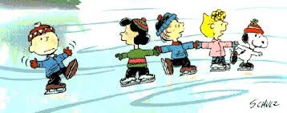
Club Programing Ideas
Work with other clubs in area/region
Bring in outside mentor Coaches and Skaters
Assist club coaches with training
Work with minor hockey
(CANPowerSkate)
Host club seminar/camp
Performance nights
Invite a friend
Parent & Tot Skate/Adult skating
Club skaters perform at hockey games
Work with other cubs and communities
Synchro skating
Celebrate accomplishments
move skaters up to higher levels once they achieve skills
Work with First Nations communities.

Slide 19
Grants
Map Grant
Regional Competition Hosting Grant
Certified Club Coach: CanSkate Grant
Certified Region Coach Grant
Coach Development Grant
David Dore Mentorship Program - Information & Application

Slide 20
Resources
Skate Canada Saskatchewan Section
https://skatecanadasaskatchewan.com/
Skate Canada
https://skatecanada.ca/
Skate Canada LTD Resource – Membership Site
https://members.skatecanada.ca/en-US/SignIn?ReturnUrl=%2Fen-US%2Fltd%2F%3Fintent%3D%252F
The resource is accessible on the Skate Canada’s Membership Site on the top navigation menu. Please take some time to explore and learn about Skate Canada’s new LTD resource and we look forward to working with you.
Sask. Sport
https://www.sasksport.ca/
Sask. Hockey
https://hockeysask.ca/

